Slide 1


Slide 2
Objectives
Create an ArrayList
Manipulate an ArrayList by using its methods
Traverse an ArrayList using iterators and for-each loops
Use wrapper classes and Autoboxing to add primitive data types to an ArrayList

Slide 3
Collection of Objects (Real Life)
In real life, objects often appear in groups.
For example:
Parking lots contain multiple cars.
Banks contain multiple accounts.
Stores have multiple customers.
A student has multiple assignment grades.

Slide 4
Collection of Objects (Programming)
When programming, you often gather data (objects).
This is commonly referred to as a collection.
In Java, the simplest way of collecting information is by using the ArrayList.
The Java ArrayList class can store a group of many objects.

Slide 5
Managing Students Enrolled in a Class
Say a group of students is enrolled in Java Programming 101.
You want to write a Java program to track the enrolled students.
The simplest way would be to create an array, as discussed in the previous lesson.

Slide 6
Number of rows
Using Arrays to Manage Enrolled Students
You can write a student array like this:
String students={“Mary, “Sue”, “Harry”, “Rick”, “Cindy”, “Bob”}
Consider a scenario where, after a week, two students (Mike and Larry) enroll in the course and Sue drops out.
How easy do you think it is to modify the students array to accommodate these changes?

Slide 7
Limitations of Arrays
Their size is fixed on creation and cannot grow or shrink after initialization.
You have to create manual methods to manipulate their contents.
For example: insert or delete an item from an array.

Slide 8
ArrayList Class
Arrays aren’t the only way to store lists of related data.
Java provides a special utility class called ArrayList.
The ArrayList class:
Is a part of the Java library, like the String and Math classes.
It can be used to store a list of objects.
Has a set of useful methods for managing its elements:
add(), get(), remove(), indexOf(), and many others.

Slide 9
What Can an ArrayList Contain?
An ArrayList can contain only objects, not primitives.
It may contain any object type, including a type that you created by writing a class.
For example, an ArrayList can hold objects of type:
String
Person
Car

Slide 10
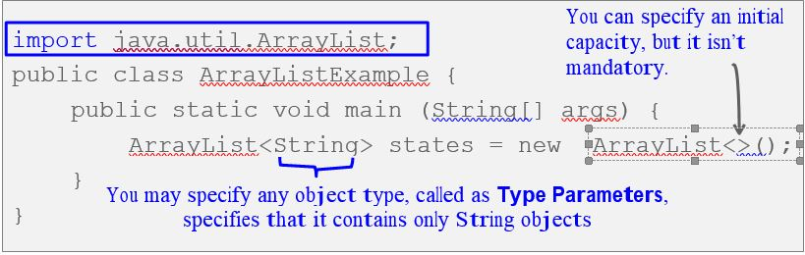
Importing and Declaring an ArrayList
You must import java.util.ArrayList to use an ArrayList.

Slide 11
Working with an ArrayList
You don’t access elements in an ArrayList by using index notation.
Instead, you use a series of methods that are available in the ArrayList class.

Slide 12
Some ArrayList Methods
add(value) | Appends the value to the end of the list
add(index, value) | Inserts the given value just before the given index, shifting subsequent values to the right
clear() | Removes all elements of the list
indexOf(value) | Returns the first index where the given value is found in the list (-1 if not found)
get(index) | Returns the value at the given index
remove(index) | Removes the value at the given index, shifting subsequent values to the left
set(index, value) | Replaces the value at the given index with a given value
size() | Returns the number of elements in the list
toString() | Returns a string representation of the list, such as "[3, 42, -7, 15]"

Slide 13
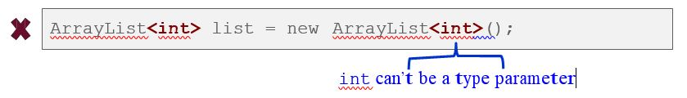
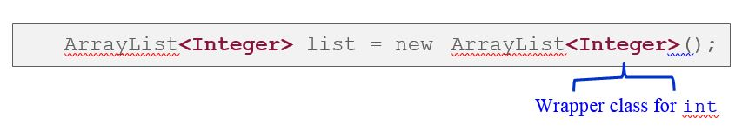
ArrayList and Primitives
An ArrayList can store only objects, not primitives.
But you can still use ArrayList with primitive types by using special classes called wrapper classes.

Slide 14
Wrapper Classes
Java provides classes, known as wrapper classes, that correspond to the primitive types.
These classes encapsulate, or wrap, the primitive types within an object.
The eight wrapper class types correspond to each primitive data type.

Slide 15
List of Wrapper Classes
List of primitive data types and their corresponding wrapper classes:
Primitive Type | Wrapper Type
byte | Byte
Short | Short
int | Integer
long | Long
float | Float
double | Double
char | Character
boolean | Boolean

Slide 16
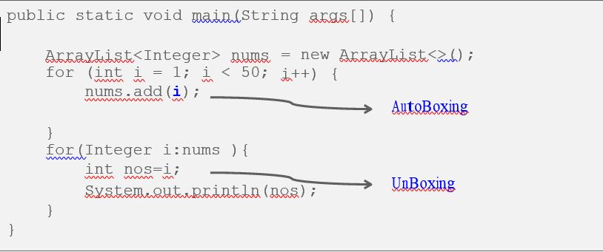
ArrayList and Wrapper Classes
Wrapper classes allow an ArrayList to store primitive values

Slide 17
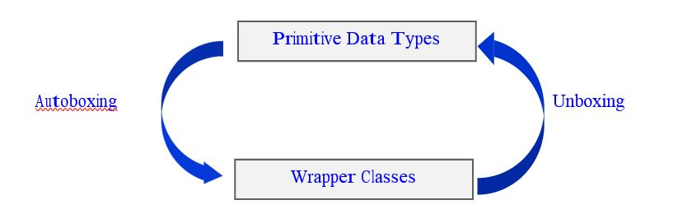
Introducing AutoBoxing and Unboxing
Java has a feature called Autoboxing and Unboxing.
This feature performs automatic conversion of primitive data types to their wrapper classes and vice versa.
It enables you to write leaner and cleaner code, making it easier to read.

Slide 18
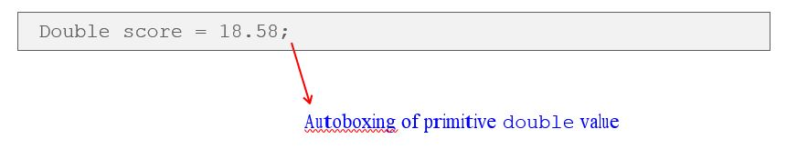
What Is Autoboxing?
The automatic conversion that the Java compiler makes between the primitive types and their corresponding object wrapper classes.

Slide 19
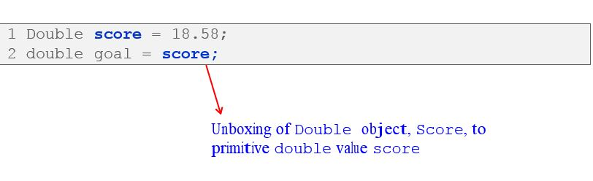
What Is Unboxing?
Converting an object of a wrapper type to its corresponding primitive value.

Slide 20
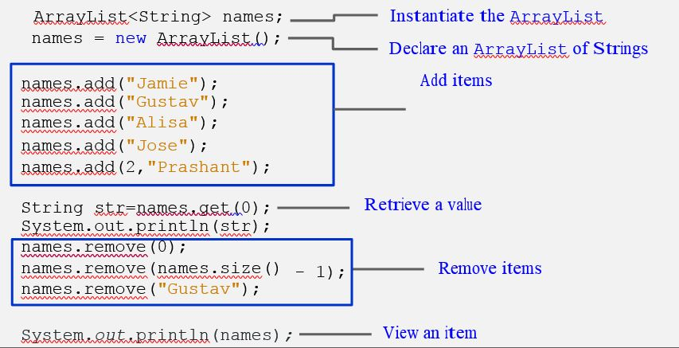
Working with an ArrayList

Slide 21
Benefits of the ArrayList Class
Dynamic resizing:
An ArrayList grows as you add elements.
An ArrayList shrinks as you remove elements.
Several built-in methods:
An ArrayList has several methods to perform operations.
For example, to add, retrieve, or remove an element.

Slide 22
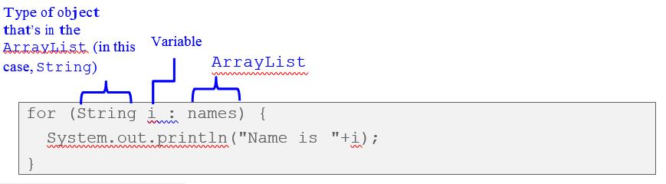
Traversing an ArrayList: for-each Loop
In the previous lesson, you used a for-each loop to traverse an array.
You can use a for-each loop to traverse an ArrayList.
The variable i represents a particular name as you loop through the names ArrayList.

Slide 23
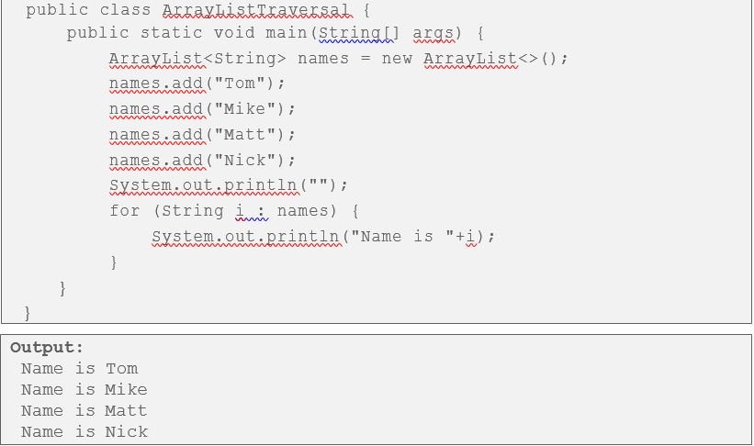
Traversing an ArrayList: for-each Loop

Slide 24
Introducing Iterator
Is a member of the collections framework.
Enables traversing through all elements in the
ArrayList, obtaining or removing elements.
Has the following methods:
hasNext(),next(),remove()
Is only used to traverse forward.
You must import java.util.Iterator to use an Iterator.

Slide 25
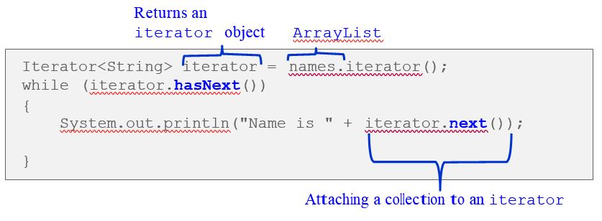
Traversing an ArrayList: Iterator
example of traversing the names collection

Slide 26
Introducing ListIterator
Is a member of the collections framework.
Allows you to traverse the ArrayList in both directions.
Doesn’t contain the remove method.
You must import java.util.ListIterator to use an ListIterator.

Slide 27
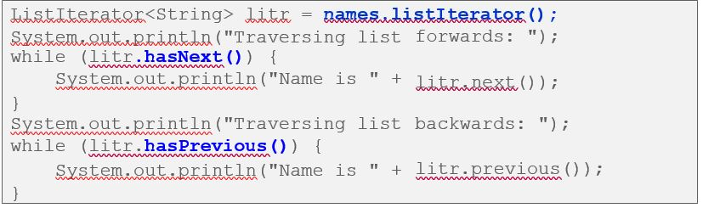
Traversing an ArrayList: ListIterator
using ListIterator to traverse the names ArrayList in forward and backward directions:

